Slide 1
US Energy Analysis
Project 2 – Group 4
Vipul Aggarwal, Kannika Phadoungxath, June Wang, Liliana Joya

Slide 2
Introduction
The increasing demand for energy in our modern world and how to satisfy it is a question that concerns the population and our leaders from a political, engineering and sustainability perspective.
The scope of this project is aimed at understanding the production and consumption of energy in the US, based on data for 2018. Where is it being produced? Where is it being consumed? What are the sources of the energy that we are consuming? And how is the role of renewables changing over the years?

Slide 3

Objectives
Present the general overview of energy production by sources and consumption per state in the US.
Evaluate the production sources in each state
Evaluate the energy production and consumption from renewable sources over the years

Slide 4
Data sources
US Energy Information Administration https://www.eia.gov/state/?sid=US
Energy production and consumption for each State for 2018
CO2 Emission data for each State for 2018
Energy production by source for each State for 2018
Renewable energy production by source from 1950-2018
Geojson for US State geography.

Slide 5

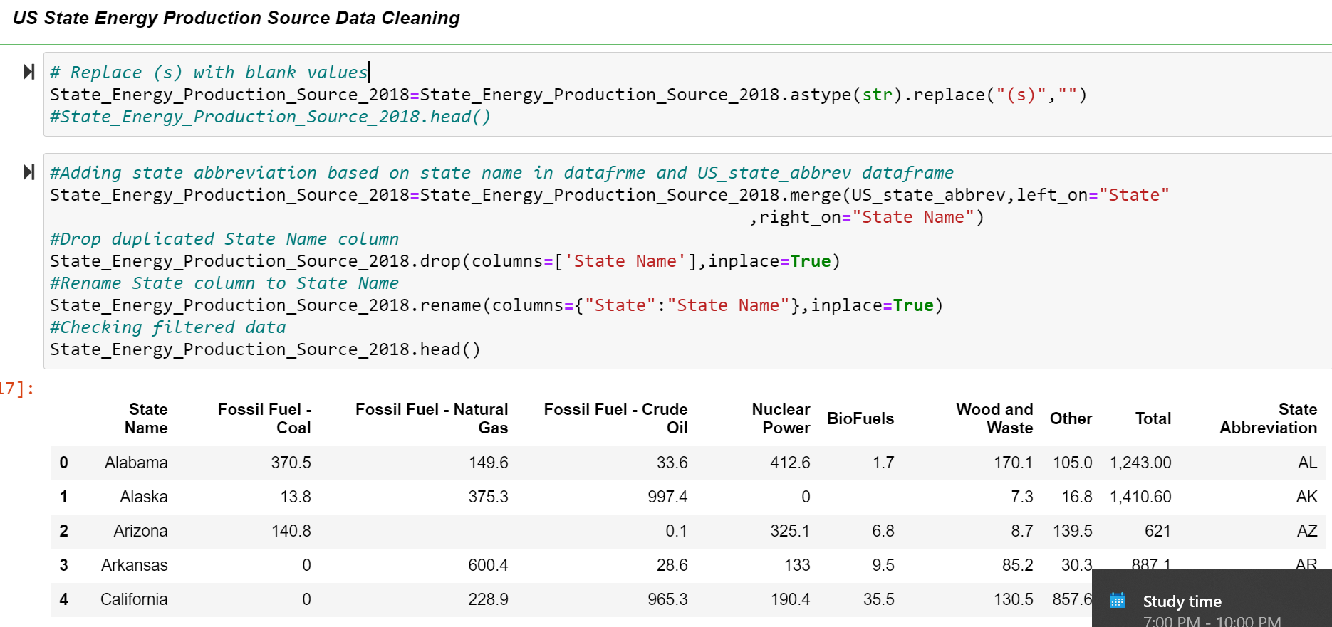

ETL
Used pandas to perform data cleaning; converted NaN values to 0 for visualization purposes
Renamed columns and collections and merged some data to have fewer collections
Merged geojson for states and energy data to create unified geojson file for choropleth plotting
Loaded data into MongoDB

Slide 6
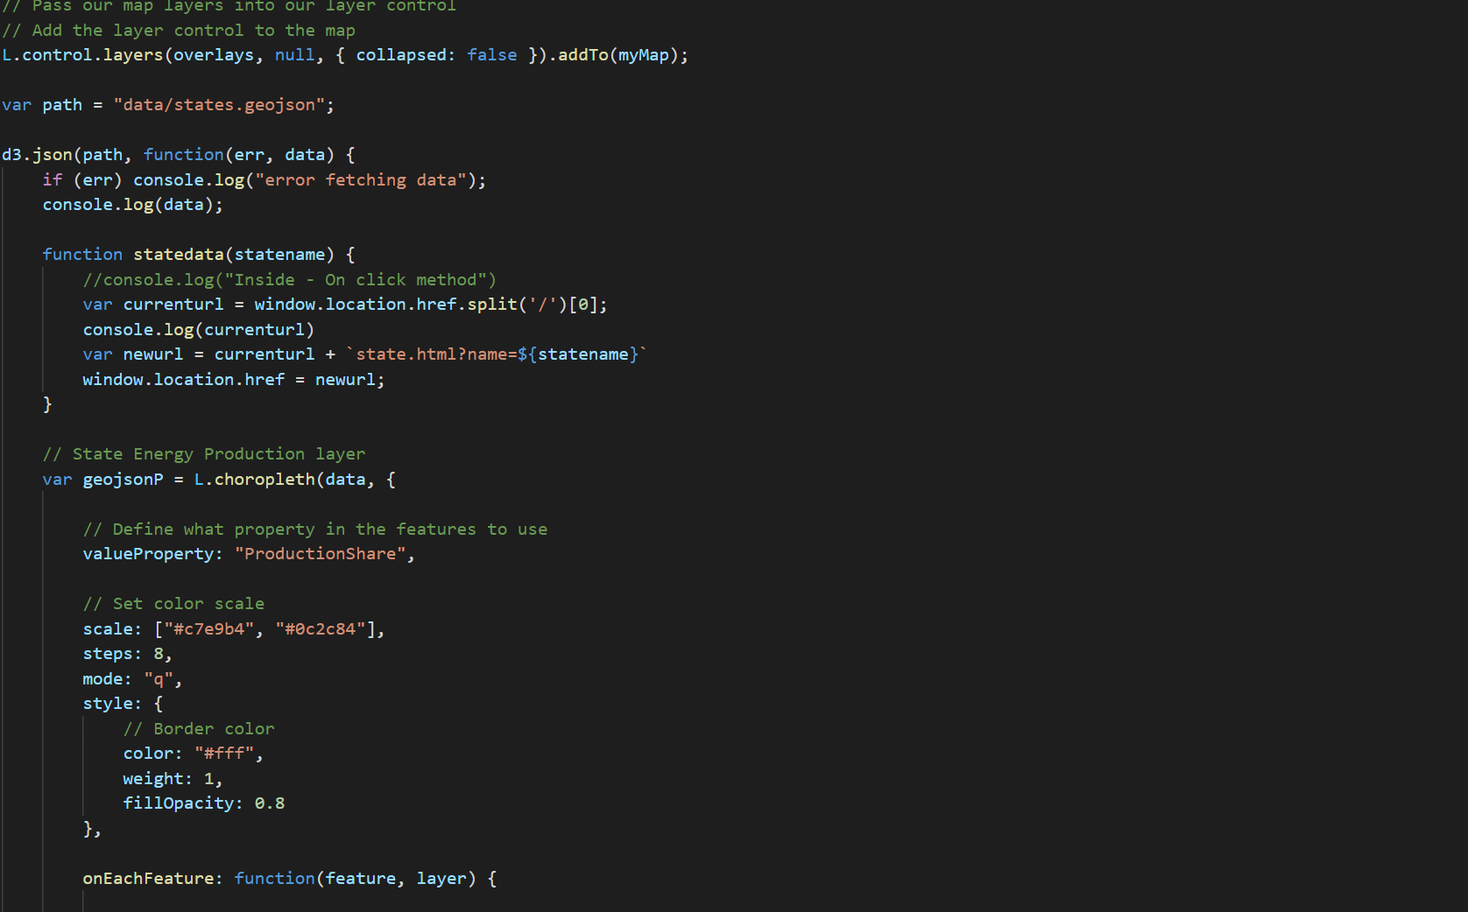
Visualization coding
Created flask app to retrieve data from mongodb and create routes to pass data required for visualization
Used Leaflet and Choropleth to present layers of production, consumption and emission using geographical location for each state. The map can be filtered by those three variables to produce color scaled visualization. Clicking on state feature will take user to state data page
Used a new library charts.js to produce visualizations for state production by source and used d3 to produce filter with dropdown of list of state and be able to change state within page
Used d3 to produce visualization for renewable energy production over the years, with line marker that tracks the values and added a translate function to change between production and consumption data

Slide 7
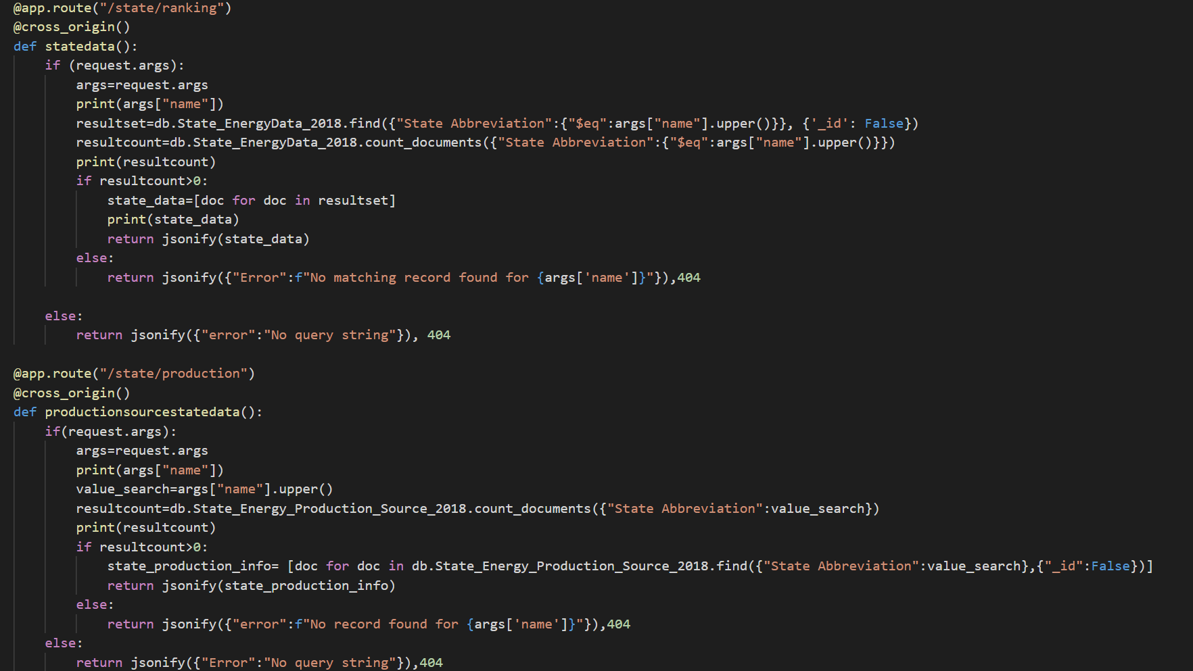
Demo
US Energy Analysis for the year 2018

Slide 8
Conclusions
Texas is the state with the largest production, producing 433 million BTU, equally producing the highest CO2 emissions, but it’s only 6th in consumption. Additionally, coal and natural gas amounts to almost two thirds of the production.
Wyoming is ranked at the top of the consumption per capita data, this is in part because of the low population compared to the large energy consumed by its natural gas, crude oil and coal extraction industry.
New York ranked 19 in production and 50 in the consumption per capita. This is partly because of the high density and because the nature of its industries.
Renewable energy sources started to peak in the mid 70’s with biomass still leading the share of production.
Solar, wind and “newer” renewable energy sources are not shown in the graph, showing also the small share they have for the broad spectrum of energy sources in the US currently.

Slide 9
Any questions?
Thank you!
z

